Slide 1
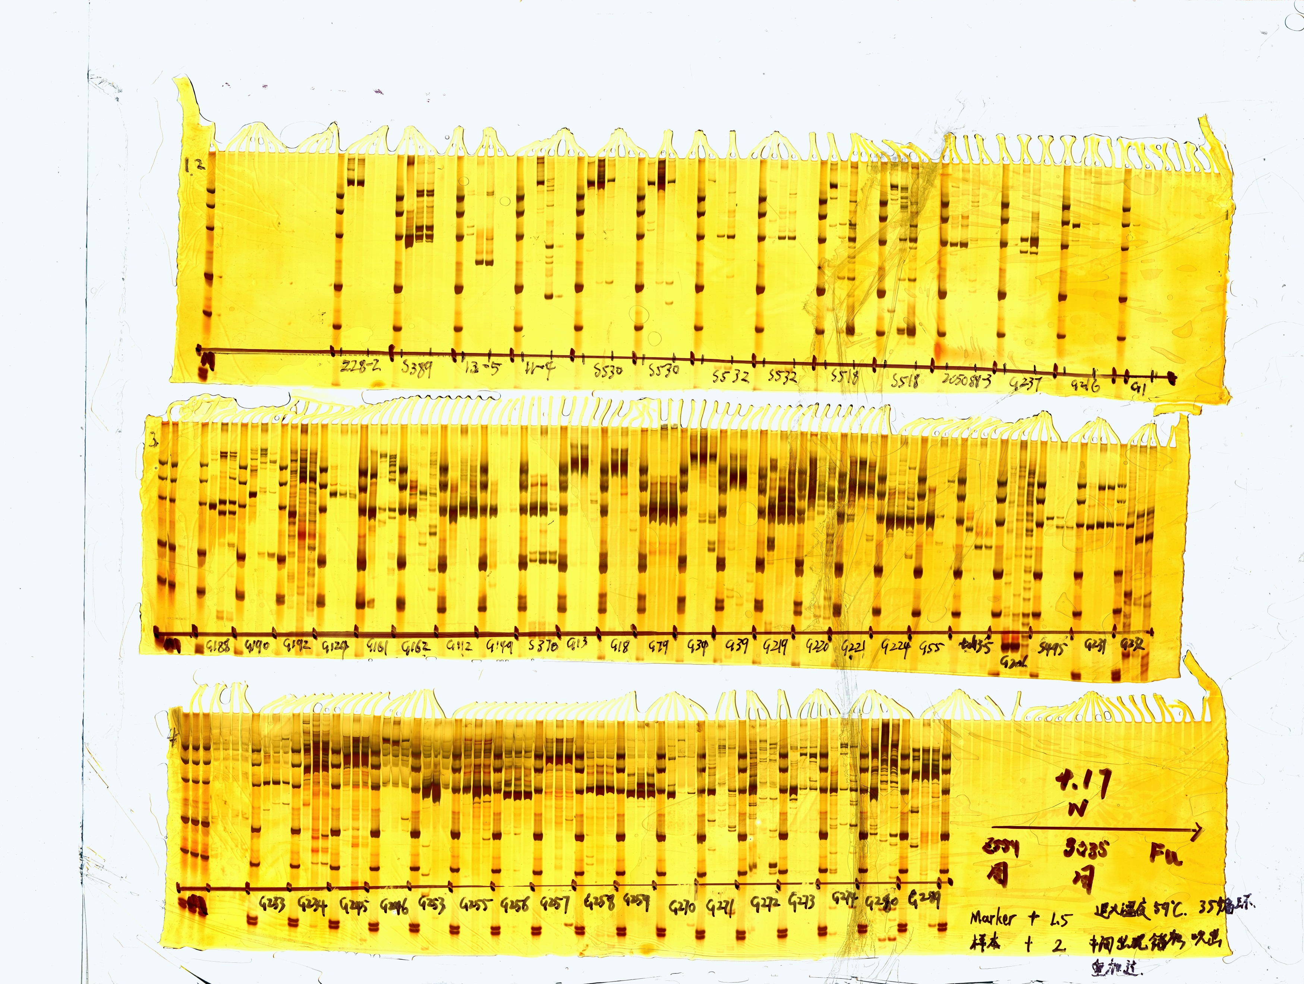




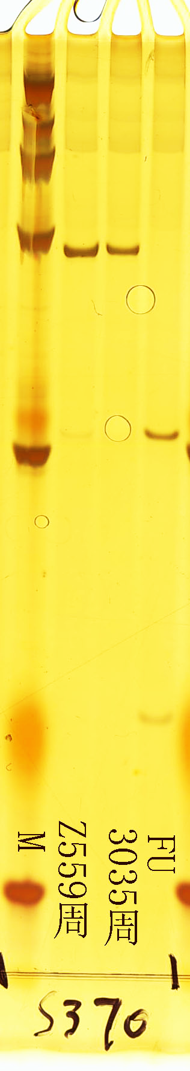
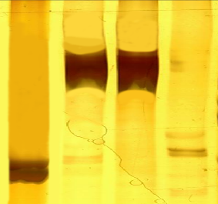
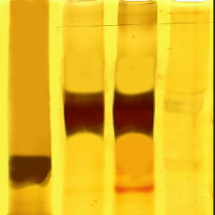


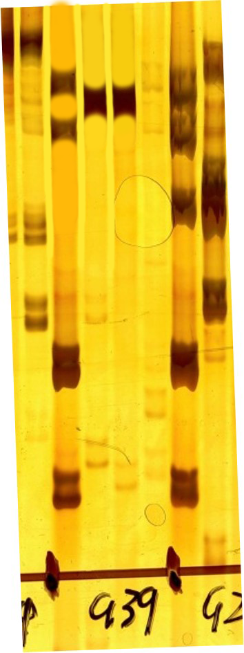
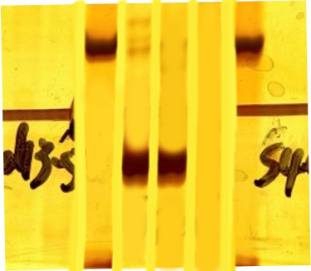
M
1
2
3
M
1
2
3
M
1
2
3
M
1
2
3
300bp
500bp
300bp
300bp
WGRG1
WGRG2
WGRG3
WGRG4
M
1
2
3
M
1
2
3
M
1
2
3
M
1
2
3
300bp
500bp
1000bp
1000bp
WGRG5
WGRG6
WGRG7
WGRG8
M
1
2
3
M
1
2
3
M
1
2
3
M
1
2
3
250bp
2000bp
2000bp
500bp
1000bp
WGRG9
WGRG10
WGRG11
WGRG12

Slide 2






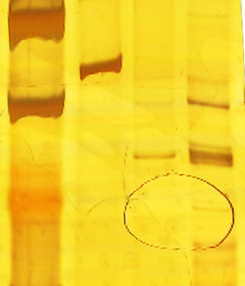

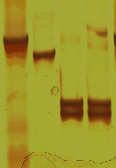

M
1
2
3
M
1
2
3
M
1
2
3
M
1
2
3
500bp
500bp
2000bp
300bp
WGRG13
WGRG14
WGRG15
WGRG16
M
1
2
3
M
1
2
3
M
1
2
3
M
1
2
3
400bp
300bp
300bp
500bp
WGRG17
WGRG18
WGRG19
WGRG20
M
1
2
3
M
1
2
3
M
1
2
3
M
1
2
3
500bp
500bp
500bp
300bp
WGRG21
WGRG22
WGRG23
WGRG24

